Slide 1

Unit:1.1 Indeterminate Forms
Mathematics-I
GTU#(3110014)
Prof. Dhvanik H. Zala
Humanities & Science
dhvanik.zala@darshan.ac.in
8238588865

Slide 2




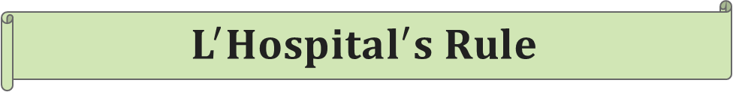

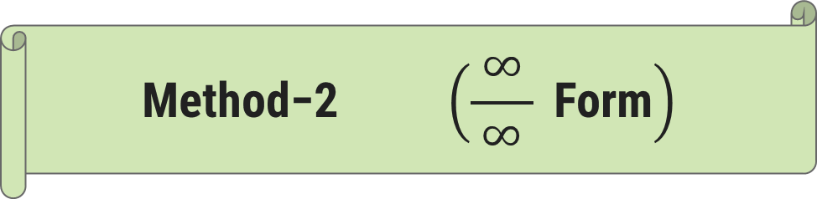
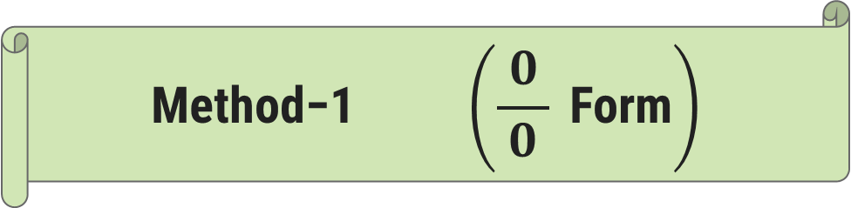
$What is Indeterminate Forms?$
$$L^{′}Hospital^{′}s Rule$$
O U T L I N E
$$\text{Method}\text{−1} \left(\frac{ 0 }{0} \text{Form}\right)$$
$$\text{Method}\text{−2} \left(\frac{ ∞ }{∞} \text{Form}\right)$$

Slide 3
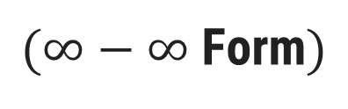
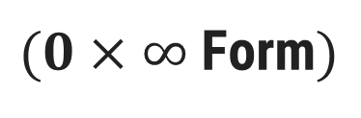
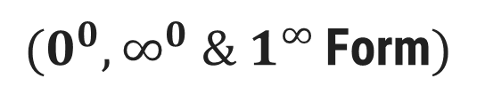
Method-3
$(0×∞$Form$)$
O U T L I N E
Method-4
$(∞−∞$Form$)$
Method-5
$(0^{0}, ∞^{0} \& 1^{∞ }$Form$)$

Slide 4

What is Indeterminate Form?

Slide 5
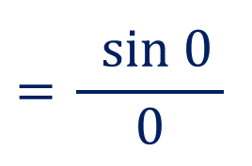
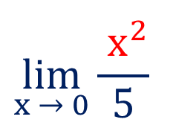
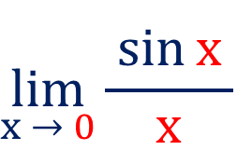
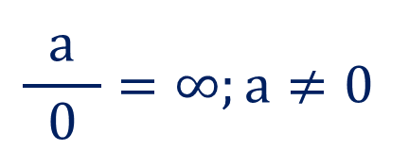
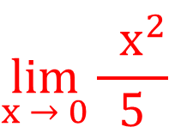
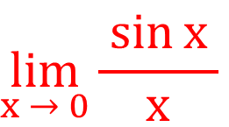
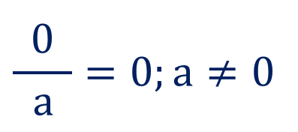
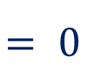
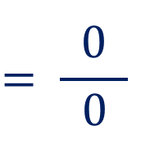
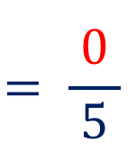

What is Indeterminate Forms?
$$\lim_{x → 0}{\frac{{ x}^{2}}{5}}$$
Suppose we want to find
$$\lim_{x → 0}{\frac{ x^{2}}{5}}$$
$$= \frac{0}{ 5 }$$
$$\frac{0}{ a }=0;a≠0$$
$$= 0$$
Then,
$$\lim_{x → 0}{\frac{\sin{x }}{x}}$$
Now, if we want to find
$$\frac{a}{ 0 }=∞;a≠0$$
$$\lim_{x → 0}{\frac{\sin{x }}{x}}$$
$$={\frac{ sin 0 }{0}}$$
$$= \frac{0}{ 0 }$$
Then,
The form$\frac{ 0 }{0}$is called Indeterminate
Form

Slide 6
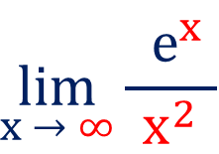
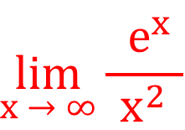

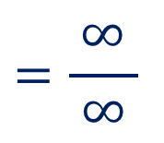
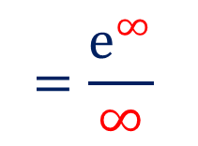
What is Indeterminate Forms?
$$\lim_{x → ∞}{\frac{{ e}^{x} }{x^{2}}}$$
Suppose we want to find
Then,
$$\lim_{x → ∞}{\frac{{ e}^{x} }{x^{2}}}$$
$$=\frac{e^{∞}}{∞}$$
$$=\frac{∞}{ ∞ }$$
The form$\frac{ ∞ }{∞}$is called Indeterminate Form

Slide 7

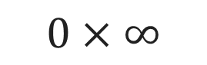
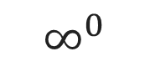
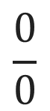
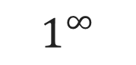
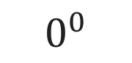
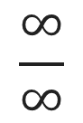
Types of Indeterminate Forms
$$∞−∞$$
$$0×∞$$
$$0^{0}$$
$$\frac{∞}{∞}$$
$$1^{∞}$$
$$\frac{0}{0}$$
$$∞^{0}$$

Slide 8
L’Hospital’s Rule

Slide 9
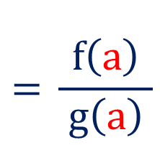
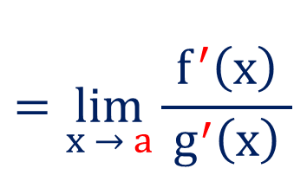
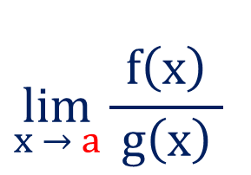
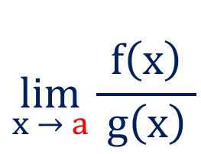
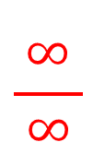
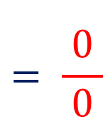
L’Hospital’s Rule
L’Hospital’s rule provides a technique to evaluate limits of indeterminate forms.
This rule converts an indeterminate forms to an expression which helps to
evaluate limit easily.
If
$$\lim_{x → a}{\frac{f\left(x\right)}{ g\left(x\right) }}$$
$$={\frac{f\left(a\right)}{ g\left(a\right) }}$$
$$= \frac{0}{ 0 }$$
$$\frac{∞}{ ∞ }$$
or
then
$$\lim_{x → a}{\frac{f\left(x\right)}{ g\left(x\right) }}$$
$$=\lim_{x → a}{\frac{f^{′}\left(x\right)}{ g^{′}\left(x\right) }}$$
provided the later limit exists.

Slide 10
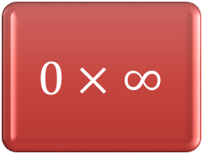
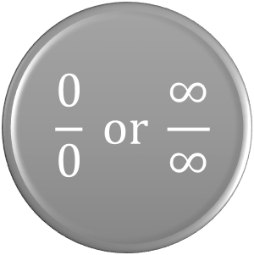
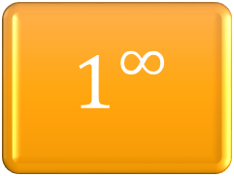
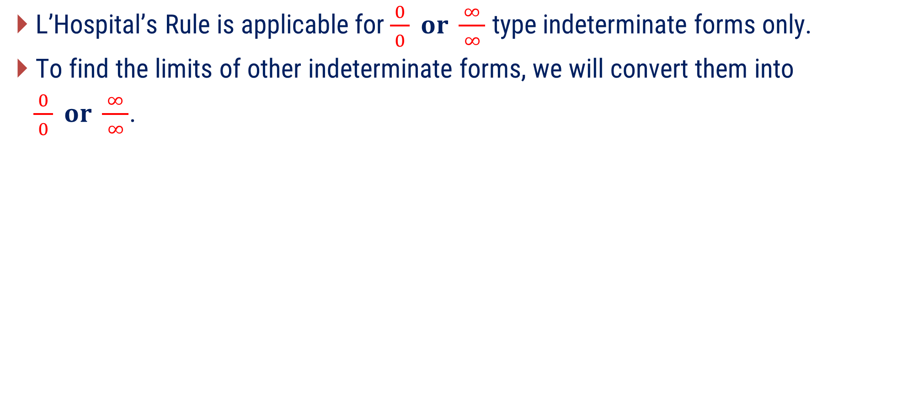
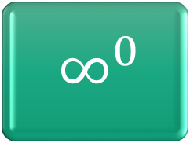
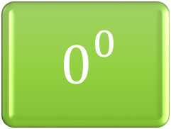
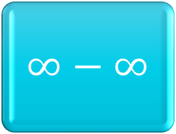
L’Hospital’s Rule
L’Hospital’s Rule is applicable for $\frac{ 0 }{ 0 } or \frac{∞}{ ∞ }$ type indeterminate forms only.
To find the limits of other indeterminate forms, we will convert them into
$\frac{0}{ 0 } or \frac{∞}{ ∞ }$.
$$∞^{0}$$
$$0^{\begin{aligned}0 \\ \end{aligned}}$$
$$1^{∞}$$
$$\frac{0}{0} or \frac{∞}{∞}$$
$∞−∞$
$$0×∞$$

Slide 11

Method:1 $\frac{0}{ 0 } Form$

Slide 12
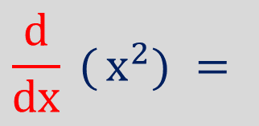
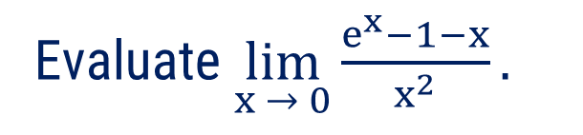
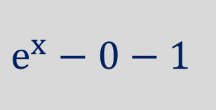
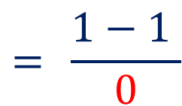
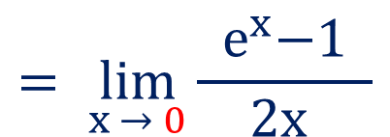
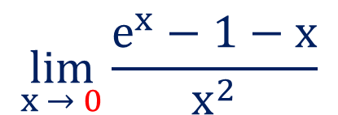
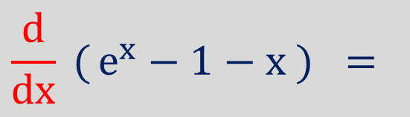
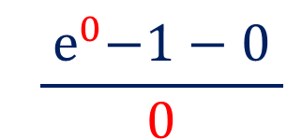
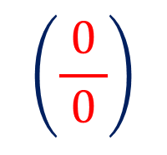
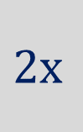
Method:1 $\left(\frac{ 0 }{0} \text{Form}\right)$
Identify the indeterminate form.
Apply L’Hospital’s Rule.
Example:1
Evaluate $\lim_{x → 0}{\frac{e^{x}−1−x}{x^{2}}.}$
Solution:
$$\lim_{x → 0}{\frac{e^{x}−1−x}{x^{2}}}$$
$${\frac{{ e}^{0}−1−0 }{0}}$$
$$={\frac{1−1 }{0}}$$
$$\left(\frac{ 0 }{0}\right)$$
$$= \lim_{x → 0}{\frac{{ e}^{x}−1 }{2x }}$$
$$\frac{d}{dx} ({e^{x}−1−x }) =$$
$$e^{x}−0−1$$
$$\frac{d}{dx} ({x^{2}}) =$$
$$2x$$

Slide 13
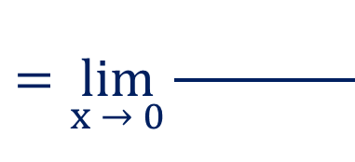









Method:1 $⟹$Example:1(Continue)
Apply the limit.
$$=\lim_{x → 0}{\frac{e^{x}−0−1}{2x}}$$
$$=\lim_{x → 0}{\frac{e^{x}−1}{2x}}$$
$${\frac{e^{0}−1}{2∙0}}$$
$${= \frac{1−1}{0}}$$
$$\left(\frac{ 0 }{0}\right)$$
$$=\lim_{x → 0}{\frac{e^{x}− 1}{2x}}$$
$$e^{x}−0$$
$$2$$
By L’Hospital’s Rule
$$=\frac{e^{0}}{2}$$
$$=\frac{1}{2}$$
If it again reduces to the form $\frac{0}{ 0 }$ or $\frac{∞}{ ∞ },$ apply L’Hospital’s Rule.

Slide 14






















Method:1 $\left(\frac{ 0 }{0} \text{Form}\right)$
$$\sin{x}$$
$$\tan{x}$$
Example:2
$$Find\lim_{x → 0}{\frac{ }{x}}$$
$$Find\lim_{x → 0}{\frac{ }{x}}$$
Solution:
$$Here,\lim_{x → 0}{\frac{\sin{x}}{x}}$$
$${\frac{\sin{0}}{0}}$$
$$\left(\frac{ 0 }{0}\right)$$
$$Here,\lim_{x → 0}{\frac{\tan{x}}{x}}$$
$${\frac{\tan{0}}{0}}$$
$$\left(\frac{ 0 }{0}\right)$$
$$\cos{x}$$
$$\sec^{2}{x}$$
$$= \lim_{x → 0}\left(\frac{ }{ }\right)$$
$$= \lim_{x → 0}\left(\frac{ }{ }\right)$$
$∵$L’Hospital’s Rule
$∵$L’Hospital’s Rule
$$1$$
$$1$$
$$=\frac{\cos{0}}{1}$$
$$=\frac{\sec^{2}{0}}{1}$$
$$=1$$
$$=1$$

Slide 15












Method:1 $\left(\frac{ 0 }{0} \text{Form}\right)$
Apply the limit.
Example:3
$$\lim_{x → \frac{π}{2}}$$
$$\left(\frac{ 2x−π }{\cos{x}}\right)$$
$$\left(\frac{ 0 }{0}\right)$$
Evaluate
Solution:
$$\lim_{x → \frac{π}{2}}$$
$$\left(\frac{ 2x−π }{\cos{x}}\right)$$
$$=\lim_{x → \frac{π}{2}}$$
$$2−0$$
By L’Hospital’s Rule
$$−\sin{x}$$
$$\sin{\frac{π}{2}=1}$$
$$=\left(−\frac{ 2}{ \sin{\frac{π}{2} }}\right)$$
$$=−2$$

Slide 16












Remember
$$\lim_{x → 0}\left(\frac{\sin{x }}{x}\right)=1$$
$$\lim_{x → 0}\left(\frac{ \sin^{2}{x }}{x^{2}}\right)$$
$$Note that, {\left(\sin{x}\right)}^{2}=\sin^{2}{x}$$
$$but,{\left(\sin{x}\right)}^{2}≠\sin{x^{2}}$$
$$=\lim_{x → 0}{\left(\frac{\sin{x }}{x}\right)}^{2}$$
$$={ \left( \lim_{x → 0}\frac{\sin{x }}{x} \right)}^{2}$$
$$=1^{2}$$
$$=1$$
$$\lim_{x → 0}\left\{\frac{ \sin^{8}{3x} }{{\left(3x\right)}^{8}}\right\}$$
$${= \left(\lim_{3x → 0}\frac{\sin{3x }}{3x}\right)}^{8}$$
$$=1^{8}$$
$$=1$$

Slide 17











Method:1 $\left(\frac{ 0 }{0} \text{Form}\right)$
Example:4
Evaluate $\lim_{x → 0}\left\{\frac{{ \left(\sin{x}\right)}^{2}−x^{2} }{x^{2}{\left(\sin{x}\right)}^{2}}\right\}$
Solution:
$$=\lim_{x → 0}\left\{\frac{{\left(\sin{x}\right)}^{2}−x^{2}}{x^{4}∙{\left(\frac{\sin{x }}{x}\right)}^{2}}\right\}$$
$$Here,\lim_{x → 0}\left\{\frac{{ \left(\sin{x}\right)}^{2}−x^{2} }{x^{2}{\left(\sin{x}\right)}^{2}}\right\}$$
$$\left(1\right)$$
$$=\lim_{x → 0}\left\{\frac{{\left(\sin{x}\right)}^{2}−x^{2}}{ ∙\frac{x^{2}{\left(\sin{x}\right)}^{2}}{ }}\right\}$$
$$=\lim_{x → 0}\left(\frac{\sin^{2}{x}−x^{2} }{x^{4}∙ }\right)$$
$$\left(\frac{ 0 }{0}\right)$$
$$x^{2}$$
$$x^{2}$$
$$=\lim_{x → 0}\left\{\frac{ {\left(\sin{x}\right)}^{2}−x^{2} }{x^{4}∙\left(\frac{\sin^{2}{x }}{x^{2}}\right)}\right\}$$
$$\lim_{x → 0}\left(\frac{\sin{x} }{x}\right)=1$$

Slide 18















Method:1 $⟹$Example:4(Continue)
Apply L’Hospital’s Rule
$$=\lim_{x → 0}\left( \frac{\sin^{2}{x}−x^{2}}{x^{4}} \right)$$
$$\left(\frac{ 0 }{0}\right)$$
$$\frac{d}{dx}({\sin^{2}{x}} )=2\sin{x}\cos{x}$$
$$2\sin{x}\cos{x}$$
$$− 2x$$
$$=\lim_{x → 0}\left(\frac{ }{ }\right)$$
$$4x^{3}$$
$$=\lim_{x → 0}\left(\frac{\sin{2x}−2x }{4x^{3}}\right)$$
$$\left(\frac{\sin{0}−2\left(0\right) }{4∙0}\right)$$
$$\left(\frac{ 0 }{0}\right)$$
$$2\sin{x}\cos{x}=\sin{2x}$$
$$2(\cos{2x})−2$$
$$=\lim_{x → 0}\left(\frac{ }{ }\right)$$
By L’Hospital’s Rule
$$12x^{2}$$
$$\frac{d}{dx}\left(\sin{2x}\right)=2∙(cos 2x)$$

Slide 19


















Method:1 $⟹$Example:4(Continue)
$$=\lim_{x → 0}\left(\frac{ 2\left(\cos{2x}\right)−2 }{12x^{2}}\right)$$
$$\left(\frac{ 2\cos{0−2 }}{12∙0}\right)$$
$$= \left(\frac{ 2\left(1\right)−2 }{0}\right)$$
$$\left(\frac{ 0 }{0}\right)$$
$$4(−sin 2x)−0$$
$$\left(\frac{ 0 }{0}\right)$$
$$\frac{d}{dx}\left(\cos{2x}\right)=2∙(−sin 2x)$$
$$=\lim_{x → 0}\left(\frac{ }{ }\right)$$
By L’Hospital’s Rule
$$24x$$
$$=\lim_{x → 0}\left(\frac{ −4\left(2∙cos 2x\right) }{ }\right)$$
$$\frac{d}{dx}\left(\sin{2x}\right)=2∙(cos 2x)$$
By L’Hospital’s Rule
$$24$$
$$=\lim_{x → 0}\left(\frac{ −8\cos{2x }}{24}\right)$$
$$= \frac{ −8\cos{0 }}{24}$$
$$=−\frac{8}{24}$$
$$=−\frac{1}{3}$$

Slide 20












Method:1 $\left(\frac{ 0 }{0} \text{Form}\right)$
Example:5
Evaluate $\lim_{x → 0}\left(\frac{ e^{x}+e^{−x}−x^{2}−2 }{{\left(\sin{x}\right)}^{2}−x^{2}}\right)$
Solution:
$$Here, \lim_{x → 0}\left(\frac{ e^{x}+e^{−x}−x^{2}−2 }{\sin^{2}x−x^{2}}\right)$$
$$\frac{{ e}^{0}+ e^{0}−0−2 }{\sin^{2}0−0}$$
$$= \frac{1+1−2}{0}$$
$$\left(\frac{ 0 }{0}\right)$$
$$e^{x}+\left(−e^{−x}\right)−2x−0$$
$$=\lim_{x → 0}\left(\frac{ }{ }\right)$$
By L’Hospital’s Rule
$$2\sin{x}\cos{x}−2x$$
$$\frac{d}{dx}({\sin^{2}{x}})=2\sin{x}\cos{x}$$
$$=\lim_{x → 0}\left(\frac{ e^{x}−e^{−x}−2x }{\sin{2x}−2x}\right)$$
$$2\sin{x}\cos{x}=\sin{2x}$$

Slide 21



















Method:1 $⟹$Example:5(Continue)
$$=\lim_{x → 0}\left(\frac{ e^{x}−e^{−x}−2x }{\sin{2x}−2x}\right)$$
$$\frac{ e^{0}−e^{0}−2\left(0\right) }{sin 0−2(0)}$$
$$= \frac{ 1−1−0 }{0}$$
$$\left(\frac{ 0 }{0}\right)$$
$$=\lim_{x → 0}\left(\frac{/ }{ }\right)$$
$$\frac{d}{dx}\left(\sin{2x}\right)=2 (cos 2x)$$
$$e^{x}−({−e}^{−x})−2$$
By L’Hospital’s Rule
$$2\cos{2x}−2$$
$$=\lim_{x → 0}\left(\frac{ e^{x}+e^{−x}−2 }{2 cos{2x}−2}\right)$$
$$\frac{ e^{0}+e^{0}−2 }{2 cos 0−2}$$
$$= \frac{ 1+1−2 }{2\left(1\right)−2}$$
$$\left(\frac{ 0 }{0}\right)$$
$$=\lim_{x → 0}\left( \frac{ / }{ } \right)$$
$$e^{x}+{\left(−e\right)}^{−x}−0$$
$$\frac{d}{dx}\left(\cos{2x}\right)=2(−sin 2x)$$
By L’Hospital’s Rule
$$2\left\{2\left(−\sin{2x}\right)\right\}−0$$
$$=\lim_{x → 0}\left(\frac{ e^{x}−e^{−x} }{−4\sin{2x}}\right)$$

Slide 22













Method:1 $⟹$Example:5(Continue)
$$=\lim_{x → 0}\left(\frac{ e^{x}−e^{−x} }{ −4\sin{2x} }\right)$$
$$\frac{ e^{0}−e^{0} }{ −4 sin 0 }$$
$$= \frac{1−1}{ 0}$$
$$\left(\frac{ 0 }{0}\right)$$
$$=\lim_{x → 0}\left(\frac{/ }{ }\right)$$
$$e^{x}−{\left(−e\right)}^{−x}$$
$$\frac{d}{dx}\left(\sin{2x}\right)=2 (cos 2x)$$
By L’Hospital’s Rule
$$−4(2\cos{2x})$$
$$=\left(\frac{ e^{0}−\left(−e^{0}\right) }{−8\cos{0 }}\right)$$
$$=\left(\frac{ 1−\left(−1\right) }{−8\left(1\right) }\right)$$
$$=−\frac{2}{8}$$
$$=−\frac{1}{4}$$

Slide 23
















Notes(Remember this)
$$\frac{d}{dx}({x^{n}})=n∙x^{n−1}$$
Differentiate both the sides with respect to $x$
$$⟹\frac{1}{y}\frac{dy}{dx}$$
$$=x∙\frac{1}{x}+\log_{e}{x}∙(1)$$
$$\frac{d}{dx}\left(a^{x}\right)=a^{x}\log{a}$$
$$⟹\frac{1}{y}\frac{dy}{dx} =1+\log_{e}{x}$$
$$\frac{d}{dx}\left(x^{x}\right)=$$
$$?$$
$$⟹\frac{dy}{dx} = y\left(1+\log_{e}{x}\right)$$
$$Let, y=\left(x^{x}\right)$$
$$⟹\frac{d}{dx}(x^{x}) =$$
$$x^{x}\left(1+\log_{e}{x}\right)$$
$$x^{x}\left(1+\log_{e}{x}\right)$$
$$\log\left(a^{b}\right)=b\log{a}$$
$$⟹\log_{e}{y}=\log_{e}\left(x^{x}\right)$$
$$⟹\log_{e}{y}=x\log_{e}{x}$$

Slide 24
















Method:1 $\left(\frac{ 0 }{0} \text{Form}\right)$
Apply L’Hospital’s Rule
Example:6
Evaluate $\lim_{x → y}\left(\frac{ x^{y}−y^{x} }{x^{x}−y^{y}}\right)$
Solution:
$$=\frac{ y^{y}−y^{y}\log{y} }{ y^{y}\left(1+\log{y}\right) }$$
$$\lim_{x → y}\left(\frac{ x^{y}−y^{x} }{x^{x}−y^{y}}\right)$$
$$\left(\frac{ y^{y}−y^{y} }{y^{y}−y^{y}}\right)$$
$$\left(\frac{ 0 }{0}\right)$$
$$=\frac{ y^{y}\left(1−\log{y}\right) }{y^{y}\left(1+\log{y}\right)}$$
$$y x^{y−1}$$
$$=\lim_{x → y}\left(\frac{/ − }{ }\right)$$
$$y^{x}\log{y}$$
$$\frac{d}{dx}\left(a^{x}\right)=a^{x}\log{a}$$
$$\frac{d}{dx}({x^{n}})=n∙x^{n−1}$$
$$x^{x}(1+\log{x})$$
$$− 0$$
$$=\frac{ 1−\log{y }}{ 1+\log{y }}$$
$$=\left(\frac{ y y^{y−1}−y^{y}\log{y} }{y^{y}\left(1+\log{y}\right)}\right)$$
$$\frac{d}{dx}\left(x^{x}\right)=x^{x}(1+log x)$$

Slide 25













Notes(Remember this)
$$\lim_{x → ∞}{\log{x}}=∞$$
$$\lim_{x → ∞}{e^{−x}}=0$$
$$\lim_{x → ∞}{\frac{1}{x}}=$$
$$Note that,$$
$$0$$
$$\lim_{x → 0}{\log{x}}$$
$$=−∞$$
$$But,$$
$$But,$$
$$\frac{1}{∞}=Undefined$$
$$\log{0}=Undefined$$
$$\lim_{x → ∞}{e^{x}}$$
$$=∞$$

Slide 26

Method:2 $\frac{∞}{ ∞ } Form$

Slide 27
















Method:2 $\left(\frac{ ∞ }{∞} \text{Form}\right)$
Identify the indeterminate form.
Use L’Hospital’s Rule
Example:1
Evaluate $\lim_{x → a}\left\{\frac{\log\left(e^{x}−e^{a}\right) }{\log\left(x−a\right)}\right\}$
Solution:
$$\lim_{x → a}\left\{\frac{\log\left(e^{x}−e^{a}\right) }{\log\left(x−a\right)}\right\}$$
$$\left\{\frac{\log\left(e^{a}−e^{a}\right) }{\log\left(a−a\right)}\right\}$$
$$=\frac{\log{0}}{\log{0}}$$
$$=\frac{−∞ }{−∞ }$$
$$\left(\frac{ ∞ }{∞}\right)$$
$$\lim_{x → 0}\log{x}=\log{0}=−∞$$
$$\frac{1}{\left(e^{x}−e^{a}\right)}$$
$$=\lim_{x → a}\left\{\frac{ \frac{1}{\left(e^{x}−e^{a}\right)}∙\left(e^{x}−0\right) }{\frac{1}{(x−a)}∙∙\left(1−0\right)}\right\}$$
$(e^{x}−0)$
$$\left(e^{x}−e^{a}\right)$$
$$=\lim_{x → a}\left\{ \frac{ e^{x}∙ }{ }\right\}$$
$$\frac{d}{dx}\left\{\log\left( f\left(x\right) \right) \right\}=\frac{1}{f\left(x\right)}f^{′}\left(x\right)$$
$$\frac{1}{\left(x−a\right)}$$
$$\left(1−0\right)$$
$$\left(x−a\right)$$

Slide 28












Method:2 $⟹$Example:1(Continue)
Apply the limit.
$$=\lim_{x → a}\left\{\frac{{ e}^{x}\left(x−a\right) }{\left(e^{x}−e^{a}\right)}\right\}$$
$$\left\{\frac{{ e}^{a}\left(a−a\right) }{\left(e^{a}−e^{a}\right)}\right\}$$
$$\left(\frac{0}{0}\right)$$
$$e^{x}(1−0)$$
$$\left(x−a\right)e^{x}$$
$$=\lim_{x → 0}\left\{\frac{ + }{ }\right\}$$
$$\left(e^{x}−0\right)$$
$$=\lim_{x → a}\left\{\frac{{ e}^{x}\left(1+x−a\right) }{e^{x}}\right\}$$
If it again reduces to the form $\frac{0}{0} or \frac{∞}{∞},$ apply L’Hospital’s Rule.
$$=\lim_{x → a}\left(1+x−a\right)$$
$$=\left(1+a−a\right)$$
$$= 1$$

Slide 29

















Method:2 $\left(\frac{ ∞ }{∞} \text{Form}\right)$
Apply the limit.
Apply L’Hospital’s Rule
Example:2
Evaluate $\lim_{x → ∞}\left\{\frac{{ x}^{n} }{e^{x}}\right\} , n>1$
Solution:
$$\lim_{x → ∞}\left\{\frac{{ x}^{n} }{e^{x}}\right\}$$
$$\left(\frac{ ∞ }{∞}\right)$$
$$\frac{∞}{e^{∞ }}$$
$$\lim_{x → ∞}{e^{x}=∞}$$
$$n∙x^{n−1}$$
$$\frac{ n∙∞ }{e^{∞ }}$$
$$\left(\frac{ ∞ }{∞}\right)$$
$$=\lim_{x → ∞}\left(\frac{ }{ }\right)$$
$$1^{st} time−derivative$$
$$e^{x}$$
$$n∙(n−1){ x}^{n−2}$$
$$\frac{ n∙\left(n−1\right)∙∞ }{e^{∞ }}$$
$$\left(\frac{ ∞ }{∞}\right)$$
$$=\lim_{x → ∞}\left(\frac{ }{ }\right)$$
$$e^{x}$$
$$2^{nd} time−derivative$$

Slide 30



















Method:2 $⟹$Example:2(Continue)
Apply the limit.
Apply L’Hospital’s Rule
$$=\lim_{x → ∞}\left(\frac{ / }{ }\right)$$
$$n∙(n−1){ x}^{n−2}$$
$$\left(\frac{ ∞ }{∞}\right)$$
$$e^{x}$$
$$n∙\left(n−1\right)∙(n−2){ x}^{n−3}$$
$$\left(\frac{ ∞ }{∞}\right)$$
$$=\lim_{x → ∞}\left(\frac{ }{ }\right)$$
$$\frac{∞}{e^{∞ }}$$
$$3^{rd} time derivative$$
$$e^{x}$$
$${By continuing this way, n}^{th} time−derivative of \frac{{ x}^{n} }{e^{x}} is$$
$$n∙\left(n−1\right)∙\left(n−2\right)…2∙1$$
$$=\lim_{x → ∞}\left(\frac{ }{ }\right)$$
$$e^{x}$$
$$=\lim_{x → ∞}\left(\frac{ n! }{e^{x}}\right)$$
$$=\frac{n!}{{\lim_{x → ∞}e}^{x }}$$
$$→n!∙\frac{1}{∞}$$
$$=0$$
$$\lim_{x → ∞}{e^{x}=∞}$$
$$n∙\left(n−1\right)∙\left(n−2\right)…2∙1=n!$$

Slide 31

















Method:2 $\left(\frac{ ∞ }{∞} \text{Form}\right)$
Apply L’Hospital’s Rule
Example:3
Evaluate $\lim_{x → 0}{\log_{\tan{x}}\tan{2x}}$
Solution:
$$\log_{x}{y}=\frac{\log_{a}{y}}{\log_{a}{x}}$$
$$\lim_{x → 0}{\log_{\tan{x}}\tan{2x}}$$
$$=\lim_{x → 0}{\frac{ \log_{e}\tan{2x} }{\log_{e}{\tan{x}}}}$$
$$\frac{ \log_{e}\tan{0} }{\log_{e}{\tan{0}}}$$
$$= \frac{\log_{e}0 }{\log_{e}{0}}$$
$$\frac{→−∞ }{→−∞ }$$
$$\left(\frac{ ∞ }{∞}\right)$$
$$=\lim_{x → 0}\left(\frac{ \frac{\frac{1}{}}{\tan{2x}}∙\sec^{2}{2x} (2 }{\frac{\frac{1}{}}{\tan{x}}∙\sec^{2}{x} (1)}\right)$$
$$\frac{1}{\tan{2x}}$$
$$\lim_{x → 0}\log{x}=\log{0}=−∞$$
$$∙\sec^{2}{2x}$$
$$(2)$$
$$\frac{d}{dx}\left\{\log\left( f\left(x\right) \right) \right\}=\frac{1}{f\left(x\right)}f^{′}\left(x\right)$$
$$\frac{1}{\tan{x}}$$
$$∙\sec^{2}{x}$$
$$(1)$$

Slide 32


















Method:2 $⟹$Example:3(Continue)
$$=\lim_{x → 0}\left(\frac{ \frac{1}{\tan{2x}}∙\sec^{2}{2x} (2) }{\frac{1}{\tan{x}}∙\sec^{2}{x} (1)}\right)$$
$$=\lim_{x → 0}\left(\frac{ 2x∙ \sec^{2}2x }{2x∙ \sec^{2}{x}}\right)$$
$$2$$
$$\tan{2x}$$
$$\tan{x}$$
$$\lim_{x → 0}{\frac{\tan{x}}{x}}=1$$
$$=\lim_{x → 0}\left(\frac{\sec^{2}{2x }}{\sec^{2}{x}}\right)$$
$$=\lim_{x → 0}\left(\frac{\sec^{2}{2x} }{ \sec^{2}{x}}\right)$$
$$\lim_{x → 0}{\frac{\tan{2x}}{2x}}=1$$
$$=\left(\frac{\sec^{2}{0 }}{\sec^{2}{0}}\right)$$
$$=\lim_{x → 0}\left(\frac{ 2∙ \frac{tan x}{ } \sec^{2} 2x }{ ∙\frac{tan 2x}{ } \sec^{2}x}\right)$$
$$x$$
$(1)$
$$x$$
$$2x$$
$$(1)$$
$$=1$$
$$2x$$

Slide 33

Method:3 $0×∞ Form$

Slide 34







Indeterminate Form: $0×∞$
Convert $f\left(x\right)∙g(x)$ into $\frac{f\left(x\right)}{1/g(x)}$ or $\frac{g\left(x\right)}{1/f(x)}$
Always put logarithmic Function (log) on the numerator.
$$0×∞$$
$$\frac{ 0 }{\left(\frac{1}{∞}\right)}$$
$$\frac{ ∞ }{\left(\frac{1}{0}\right)}$$
$$\frac{ 0 }{0}$$
$$\frac{ ∞ }{∞}$$
i.e. $0∙∞$form will convert into $\frac{ 0 }{0}$ or $\frac{ ∞ }{∞}$ form.
Apply L’Hospital’s Rule.

Slide 35















Method:3 $(0×∞ \text{Form})$
Convert $0×∞$ into $\frac{0}{0}$ or $\frac{∞}{∞}$ form.
Identify the indeterminate form.
Example:1
Evaluate
$$\lim_{x → ∞}{ }$$
$$\{{\left(a\right)}^{\frac{1}{x}}−1\}∙x$$
Solution:
$$\lim_{x → ∞}{ }$$
$${\{\left(a\right)}^{\frac{1}{x}}−1\}∙x$$
$${\{\left(a\right)}^{\frac{1}{∞}}−1\}∙∞$$
$$\lim_{x → ∞}{\frac{1}{x}}=\frac{1}{∞}=0$$
$$={\{\left(a\right)}^{0}−1\}∙∞$$
$$=\{1−1\}∙∞$$
$$\left(0×∞\right)$$
$$\frac{{\{\left(a\right)}^{\frac{1}{x}}−1\}}{\frac{ 1 }{x}}$$
$$\frac{{\{\left(a\right)}^{\frac{1}{∞}}−1\}}{\frac{1}{∞}}$$
$$= \frac{\{1−1\}}{0}$$
$$\left(\frac{0}{0}\right)$$
$$\lim_{x → ∞}{ }$$

Slide 36















Method:3 $⟹$Example:1(Continue)
Apply L’Hospital’s Rule
$$\frac{{\{\left(a\right)}^{\frac{1}{x}}−1\}}{\frac{ 1 }{x}}$$
$$\lim_{x → ∞}{\frac{1}{x}}=\frac{1}{∞}=0$$
$$\left(\frac{0}{0}\right)$$
$$={\left(a\right)}^{\frac{1}{∞}}∙\log{a}$$
$$=\lim_{x → ∞}{ }$$
$$={\left(a\right)}^{0}∙\log{a}$$
$$=\lim_{x → ∞}\left(\frac{ a^{\frac{1}{x}} \frac{\frac{1}{}}{} }{−\frac{1}{x^{2}} \frac{\frac{1}{}}{} }\right)$$
$$\left(−\frac{1}{x^{2}}\right)$$
$$a^{\frac{1}{x}}∙log a$$
$$=(1)∙\log{a}$$
$$\frac{d}{dx}\left(a^{y}\right)=a^{y}\log{a}$$
$$\left(−\frac{1}{x^{2}}\right)$$
$$=\log{a}$$
$$=\lim_{x → ∞}{ }$$
$${\left(a\right)}^{\frac{1}{x}}∙\log{a}$$

Slide 37












Method:3 $(0×∞$Form$)$
Evaluate $\left\{\left(\sqrt{x+1} − \sqrt{x}\right)\log\left(\frac{1}{x}\right)\right\}$
Example:2
$$\lim_{x → ∞}{ }$$
Solution:
$$\lim_{x → ∞}\left\{\left(\sqrt{x+1} − \sqrt{x}\right)\log\left(\frac{1}{x}\right)\right\}$$
$$\left\{\frac{ \left(\sqrt{x+1} − \sqrt{x}\right)\log\left(\frac{1}{x}\right)}{ }\right\}$$
$$\left(\sqrt{x+1} + \sqrt{x}\right)$$
$$=\lim_{x → ∞}{ }$$
$$\left(\sqrt{x+1} + \sqrt{x}\right)$$
$$\left\{\frac{\left[{\left(\sqrt{x+1}\right)}^{2}−{\left(\sqrt{x}\right)}^{2}\right]\log\left(\frac{1}{x}\right)}{\left(\sqrt{x+1}+ \sqrt{x}\right)}\right\}$$
$$\left[{\left(\sqrt{x+1}\right)}^{2}−{\left(\sqrt{x}\right)}^{2}\right]$$
$$=\lim_{x → ∞}{ }$$
$$\left(a+b\right)\left(a−b\right)=a^{2}−b^{2}$$
$$\left(\sqrt{x+1}+ \sqrt{x}\right)$$

Slide 38



















Method:3 $⟹$Example:2(Continue)
Apply the limit.
$$\left\{\frac{\left[{\left(\sqrt{x+1}\right)}^{2}−{\left(\sqrt{x}\right)}^{2}\right]\log\left(\frac{1}{x}\right)}{\left(\sqrt{x+1}+ \sqrt{x}\right)}\right\}$$
$$\left[{\left(\sqrt{x+1}\right)}^{2}−{\left(\sqrt{x}\right)}^{2}\right]$$
$$=\lim_{x → ∞}{ }$$
$$\left(\sqrt{x+1}+ \sqrt{x}\right)$$
$$\left\{\frac{\left[{\left(\sqrt{x+1}\right)}^{2}\right]\log\left(\frac{1}{x}\right)}{\left(\sqrt{x+1}+ \sqrt{x}\right)}\right\}$$
$$\frac{\log\left(\frac{1}{∞}\right)}{\sqrt{∞} +\sqrt{∞ }}$$
$$\left( x+1−x \right)$$
$$=\lim_{x → ∞}{ }$$
$$=\frac{ 1 }{ ∞ }∙−∞$$
$$\left(0×∞\right)$$
$$\left(\sqrt{x+1}+ \sqrt{x}\right)$$
$$\lim_{x → ∞}{\log\left(\frac{1}{x}\right)}$$
$$\left\{\frac{\log\left(\frac{1}{x}\right)}{\left(\sqrt{x+1}+ \sqrt{x}\right)}\right\}$$
$$=\lim_{x → ∞}{ }$$
$$\left(\frac{ ∞ }{∞}\right)$$
$$\lim_{\frac{1}{x} → 0}{\log\left(\frac{1}{x}\right)}$$
$\left(\sqrt{x+1}+ \sqrt{x} \right)$
$$\lim_{x → 0}{\log{x}}=−∞$$
$$=−∞$$

Slide 39




















Method:3 $⟹$Example:2(Continue)
Apply L’Hospital’s Rule
$$=\lim_{x → ∞}\left\{\frac{ \frac{1}{\frac{}{}} }{ \frac{1}{/}\frac{}{\frac{}{\frac{}{}}} } \right\}$$
$$\left(−\frac{1}{x^{2}}\right)$$
$$\left\{\frac{\log\left(\frac{1}{x}\right)}{\left( \sqrt{x+1} + \sqrt{x} \right)}\right\}$$
$$x$$
$$=\lim_{x → ∞}{ }$$
$$\left(\frac{ ∞ }{∞}\right)$$
$$\left(\sqrt{x+1} + \sqrt{x} \right)$$
$$\left(\frac{1}{2\sqrt{x}}\right)$$
$$\left(\frac{1}{\sqrt{1+\frac{1}{x}}}+1\right)$$
$$=\lim_{x → ∞}\left\{\frac{ \frac{1}{\frac{}{}} }{ \frac{1}{}\frac{}{\frac{}{}} } \right\}$$
$$\frac{1}{1/x}$$
$$\left(−\frac{1}{x^{2}}\right)$$
$$=\lim_{x → ∞}\left\{\frac{ \frac{\left( −\frac{1}{x}\right)}{}}{ \frac{1}{/}\frac{}{\frac{}{\frac{}{}}} } \right\}$$
$$\left(−\frac{1}{x}\right)$$
$$2\sqrt{x}$$
$$\left(\frac{1}{2\sqrt{x+1}}\right) +$$
$$\left(\frac{1}{2\sqrt{x}}\right)$$
$$\left(\frac{1}{\sqrt{1+\frac{1}{x}}}+1\right)$$
$$\frac{d}{dx}\left\{\log\left( f\left(x\right) \right) \right\}=\frac{1}{f\left(x\right)}f^{′}\left(x\right)$$
$$\frac{d}{dx}\left(\sqrt{x}\right)=\frac{1}{2\sqrt{x}}$$

Slide 40


















Method:3 $⟹$Example:2(Continue)
$$\left\{\frac{\frac{1}{\frac{}{}} }{ \frac{}{\frac{}{\frac{}{}}} }\right\}$$
$$\left\{\frac{\frac{}{}/}{ \frac{1}{/}\frac{}{\frac{}{\frac{}{}}} }\right\}$$
$$\left(−\frac{1}{x}\right)$$
$$−2$$
$$2\sqrt{x}$$
$$=\lim_{x → ∞}{ }$$
$$\left(\frac{1}{\sqrt{1+\frac{1}{x}}}+1\right)$$
$$=\lim_{x → ∞}{ }$$
$$\sqrt{x}$$
$$\left(\frac{1}{\sqrt{1+\frac{1}{x}}}+1\right)$$
$$=\frac{−2 }{ ∞∙\left(\frac{1}{\sqrt{1+\frac{1}{∞}}}+1\right) }$$
$$\left\{\frac{\frac{}{}/ /}{ \frac{1}{/}\frac{}{\frac{}{\frac{}{}}} }\right\}$$
$$−2\sqrt{x}$$
$$=\lim_{x → ∞}{ }$$
$$\left(\frac{1}{\sqrt{1+\frac{1}{x}}}+1\right)$$
$$\lim_{x → ∞}{\frac{1}{x}}=\frac{1}{∞}=0$$
$$x$$
$$=0$$

Slide 41

Method:4 $\left(∞−∞ Form\right)$

Slide 42







Indeterminate Form: $∞−∞$
If we have,
$$\lim_{x → a}$$
$$f\left(x\right)−g(x){ }$$
$$⟶∞−∞{ }$$
then convert it as
$$\frac{\left\{ \frac{1}{ g\left(x\right) }−\frac{1}{ f\left(x\right) } \right\}}{\left\{ \frac{1}{ f\left(x\right)∙g\left(x\right) } \right\}}$$
$$\lim_{x → a}$$
(i.e. L.C.M. in $f\left(x\right)−g\left(x\right)$)
which will transform $∞−∞$ into $\frac{0}{ 0 }.$
Apply L’Hospital’s Rule.

Slide 43




















Method:4$(∞−∞$Form$)$
Take L.C.M. in $f\left(x\right)−g\left(x\right)$
Identify the indeterminate form.
$$\left(\frac{1}{\sin{x}}−\frac{1}{x}\right)$$
Example:1
Evaluate
$$\lim_{x → 0}$$
Solution:
$$\left(\frac{1}{\sin{x}}−\frac{1}{x}\right)$$
$$\left(\frac{1}{\sin{0}}−\frac{1}{0}\right)$$
$$\lim_{x → 0}$$
$$\left(∞−∞\right)$$
$$=\lim_{x → 0}$$
$$x$$
$$− sin{x}$$
$$\left(\frac{ 0−\sin{0 }}{0}\right)$$
$$\left(\frac{0}{0}\right)$$
$$x(\sin{x})$$
$$=\lim_{x → 0}$$
$$x− sin{x}$$
$$\frac{x\left(\sin{x}\right)}{ }$$
$$x$$
$$x$$

Slide 44







































Method:4 $⟹$Example:1(Continue)
Apply L’Hospital’s Rule
$$1−cos x$$
$$1−cos 0$$
$$\left(\frac{0}{0}\right)$$
$$x− sin{x}$$
$$=\lim_{x → 0}$$
$$=\lim_{x → 0}$$
$$2\left(0\right)$$
$$2x$$
$$\frac{x\left(\sin{x}\right)}{ }$$
$$x$$
$$\left(\frac{ / }{ }\right)$$
$$x$$
$$0−\left(−sin x\right)$$
$$=\lim_{x → 0}$$
$$2$$
$$x− sin{x}$$
$$\lim_{x → 0}\left(\frac{ sin x }{x}\right)=1$$
$$=\lim_{x → 0}$$
$$sin x$$
$$=\lim_{x → 0}$$
$$\left(\frac{\sin{x }}{x}\right)$$
$$x^{2}$$
$$2$$
$$=\left(\frac{ sin 0 }{2}\right)$$
$$x− sin{x}$$
$$0−sin 0$$
$$\left(\frac{0}{0}\right)$$
$$=\lim_{x → 0}$$
$$x^{2}$$
$$\left(1\right)$$
$$0$$
$$=0$$

Slide 45

















Method:4$(∞−∞$Form$)$
Take L.C.M. in $f\left(x\right)−g\left(x\right)$
Identify the indeterminate form.
Apply L’Hospital’s Rule
$$\left(\frac{x}{ x−1 }−\frac{1}{ log x }\right)$$
Example:3
Evaluate
$$\lim_{x → 1}$$
Solution:
$$\left(\frac{x}{ x−1 }−\frac{1}{ log x }\right)$$
$$\left(\frac{1}{1−1}−\frac{1}{ \log{1} }\right)$$
$$=\left(\frac{1}{ 0 }−\frac{1}{ 0 }\right)$$
$$\lim_{x → 1}$$
$$\left(∞−∞\right)$$
$$\left(\frac{ x\left(\log{x}\right)−\left(x−1\right) }{\left(x−1\right)\log{x}}\right)$$
$$\left\{\frac{ \left(1\right)\left(\log{1}\right)−\left(1−1\right) }{\left(1−1\right)\left(\log{1}\right)}\right\}$$
$$\left(\frac{ 0 }{0}\right)$$
$$=\lim_{x → 1}$$
$$x∙\left(\frac{1}{x}\right)+\left(\log{x}\right)\left(1\right)$$
$$− \left(1−0\right)$$
$$=\lim_{x → 1}$$
$$\left(x−1\right)∙\left(\frac{1}{x}\right)+\left(\log{x}\right)∙\left(1−0\right)$$

Slide 46

















Method:4 $⟹$Example:3(Continue)
Apply L’Hospital’s Rule
$$x∙\left(\frac{1}{x}\right)+\left(\log{x}\right)\left(1\right)$$
$$− \left(1−0\right)$$
$$=\lim_{x → 1}$$
$$\left(x−1\right)∙\left(\frac{1}{x}\right)+\left(\log{x}\right)∙\left(1−0\right)$$
$$1+\left(\log{x}\right)$$
$$− 1$$
$$\left\{\frac{\log{1}}{\left(1−1\right)∙\left(1\right)+\log{1}}\right\}$$
$$\left(\frac{ 0 }{0}\right)$$
$$=\lim_{x → 1}$$
$$\left(x−1\right)∙\left(\frac{1}{x}\right)+\left(\log{x}\right)$$
$$\left(\frac{1}{x}\right)$$
$$=\lim_{x → 1}$$
$$\left(x−1\right)∙\left(−\frac{1}{x^{2}}\right)+\left(\frac{1}{x}\right)∙\left(1−0\right)$$
$$+ \left(\frac{1}{x}\right)$$

Slide 47










Method:4 $⟹$Example:3(Continue)
$$\left(\frac{1}{x}\right)$$
$$=\lim_{x → 1}$$
$$\left(x−1\right)∙\left(−\frac{1}{x^{2}}\right)+\left(\frac{1}{x}\right)∙\left(1−0\right)$$
$$+ \left(\frac{1}{x}\right)$$
$$\left(\frac{1}{1}\right)$$
$$=\left\{\frac{ \frac{}{} }{ \frac{}{} }\right\}$$
$$\left(1−1\right)∙\left(−\frac{1}{1}\right)+\left(\frac{1}{1}\right)∙\left(1−0\right)$$
$$+ \left(\frac{1}{1}\right)$$
$$=\frac{1}{2}$$

Slide 48
























Method:4 $\left(∞−∞ \text{Form}\right)$
$$\left\{\frac{1}{ x^{2} }−{\left(cot x\right)}^{2}\right\}$$
Example:2
Evaluate
$$\lim_{x → 0}$$
Solution:
$$\left\{\frac{\tan^{2}{x}−x^{2} }{\frac{\frac{ }{ }}{}}\right\}$$
$$\left\{ \frac{1}{ x^{2} }−\left(\cot^{2}{x}\right) \right\}$$
$$=\lim_{x → 0}$$
$$\frac{{ x}^{2}\tan^{2}{x}}{ }$$
$$\lim_{x → 0}$$
$$x^{2}$$
$$x^{2}$$
$$\left\{\frac{\tan^{2}{x}−x^{2} }{\frac{\frac{ }{ }}{}}\right\}$$
$$=\lim_{x → 0}$$
$$\left\{ \frac{1}{ x^{2} }−\frac{1}{\tan^{2}{x }} \right\}$$
$$\left(\frac{1}{0}−\frac{1}{\tan^{2}{0}}\right)$$
$$=\lim_{x → 0}$$
$$\left(∞−∞\right)$$
$${\left(\frac{\tan{x} }{ x}\right)}^{2}$$
$$x^{4}$$
$${\left(1\right)}^{2}$$
$$=\lim_{x → 0}$$
$$\left\{\frac{ \tan^{2}{x}−x^{2} }{x^{2}\tan^{2}{x}}\right\}$$
$$\left\{\frac{\tan^{2}{x}−x^{2} }{ }\right\}$$
$$=\lim_{x → 0}$$
$$x^{4}$$
$$\lim_{x → 0}\left(\frac{ \tan{x} }{x}\right)=1$$

Slide 49




























Method:4 $⟹$Example:2(Continue)
$$\left\{\frac{\tan^{2}{x}−x^{2} }{ }\right\}$$
$$\left(\frac{\tan^{2}{(0)}−0}{0}\right)$$
$$\left(\frac{ 0 }{0}\right)$$
$$=\lim_{x → 0}$$
$$x^{4}$$
$$\left(\frac{2\tan{0}∙\sec^{2}{0 −2(0)}}{0}\right)$$
$$\left(\frac{ 0 }{0}\right)$$
$$2\tan{x}∙\sec^{2} x$$
$$− 2x$$
$$\frac{d}{dx}(\tan^{2}{x})=2tan x∙\sec^{2} x$$
$$=\lim_{x → 0}$$
$$4x^{3}$$
$$=\lim_{x → 0}$$
$$2\tan{x}$$
$$∙(2\sec^{2}{x}∙\tan{x})$$
$$+ 2\sec^{2}{x}$$
$$\left(\sec^{2}{x}\right)$$
$$− 2$$
$${12x}^{2}$$
$$\frac{d}{dx}\left(\sec^{2}{x}\right)=2 \sec^{2} x∙tan x$$
$$4\tan^{2}{x}∙(\sec^{2}{x})$$
$$+ 2\sec^{4}{x}$$
$$− 2$$
$$\left(\frac{ 0 }{0}\right)$$
$$=\lim_{x → 0}$$
$${12x}^{2}$$

Slide 50


























Method:4 $⟹$Example:2(Continue)
$$4\tan^{2}{x}∙(\sec^{2}{x})$$
$$+ 2\sec^{4}{x}$$
$$− 2$$
$$\left(\frac{ 0 }{0}\right)$$
$$=\lim_{x → 0}$$
$${12x}^{2}$$
$$4\tan^{2}{x}$$
$$∙(2\sec^{2} x∙\tan{x})$$
$$+ 4\sec^{2}{x}$$
$$∙(2\tan{x}∙\sec^{2}{x})$$
$$=\lim_{x → 0}$$
$$+ 2(4\sec^{3} x∙\sec{x}\tan{x})$$
$$− 0$$
$$24x$$
$$8\tan^{3}{x}∙(\sec^{2} x)$$
$$+ 8(\sec^{4} x∙\tan{x})$$
$$+ 8(\sec^{4} x∙\tan{x})$$
$$=\lim_{x → 0}$$
$$24x$$
$$8\tan^{3}{x}∙(\sec^{2} x)$$
$$+ 16 (\sec^{4} x∙\tan{x})$$
$$\left(\frac{ 0 }{0}\right)$$
$$=\lim_{x → 0}$$
$$24x$$

Slide 51
























Method:4 $⟹$Example:2(Continue)
$$8\tan^{3}{x}∙(\sec^{2} x)$$
$$+ 16 (\sec^{4} x∙\tan{x})$$
$$\left(\frac{ 0 }{0}\right)$$
$$=\lim_{x → 0}$$
$$24x$$
$$\left(8\tan^{3}{x}\right)$$
$$\left(2\sec^{2} x∙\tan{x}\right)$$
$$+ \left(8 \sec^{2} x\right)$$
$$\left(3\tan^{2}{x}∙\sec^{2} x\right)$$
$$=\lim_{x → 0}$$
$$+ \left(16 \sec^{4} x\right)$$
$$\left(\sec^{2} x\right)$$
$$+ \left(16 tan x\right)$$
$$\left(4\sec^{3} x∙\sec{x}∙\tan{x}\right)$$
$$24$$
$$16\tan^{4}{x}∙(\sec^{2} x)$$
$$+ 24 (\sec^{4} x∙\tan^{2}{x})$$
$$=\lim_{x → 0}$$
$$+ 16 (\sec^{6} x)$$
$$+ 64 (\sec^{4} x∙\tan^{2}{x})$$
$$24$$

Slide 52




















Method:4 $⟹$Example:2(Continue)
$$16\tan^{4}{x}∙(\sec^{2} x)$$
$$+ 24 (\sec^{4} x∙\tan^{2}{x})$$
$$=\lim_{x → 0}$$
$$+ 16 (\sec^{6} x)$$
$$+ 64 (\sec^{4} x∙\tan^{2}{x})$$
$$24$$
$$=\lim_{x → 0}$$
$$16\tan^{4}{x}∙(\sec^{2} x)$$
$$+ 88 (\sec^{4} x∙\tan^{2}{x})$$
$$+ 16 (\sec^{6} x)$$
$$24$$
$$=\left\{\frac{ \frac{}{\frac{ }{}}}{ }\right\}$$
$$16\tan^{4}{0}∙(\sec^{2} 0)$$
$$+ 88 (\sec^{4} 0∙\tan^{2}{0})$$
$$+ 16 (\sec^{6} 0)$$
$$=\frac{16}{24}$$
$$=\frac{2}{3}$$
$$24$$

Slide 53

Method:5 $0^{0},∞^{0} \& 1^{∞} Form$

Slide 54













Indeterminate Form:$0^{0},∞^{0} and 1^{∞}$
Assume
$$y=$$
$$\lim_{x → a}$$
$$f{\left(x\right)}^{g\left(x\right)}$$
Apply Logarithm function on both the sides
$$log y=$$
$$log \left\{\lim_{x → a}f{\left(x\right)}^{g\left(x\right)}\right\}$$
$$=\left\{\lim_{x → a}log f{\left(x\right)}^{g\left(x\right)}\right\}$$
$$=\lim_{x → a}$$
$$\left\{g\left(x\right)∙log f\left(x\right)\right\}$$
$$=L$$
which leads to the indeterminate form $0×∞ or ∞×0$
Convert $0×∞ or ∞×0$ into the form $\frac{0}{ 0 } or \frac{ ∞ }{∞ }.$
We will get the value of $\log{y}.$
Use the property: $\log{y}=L$
$$⟹y=e^{L}$$

Slide 55





















Method:5$0^{0},∞^{0} and 1^{∞}$Form
Apply Logarithm function on both sides
Identify the indeterminate form.
$${\left(\frac{1}{x}\right)}^{\tan{x}}$$
$${\left(\frac{1}{0}\right)}^{\tan{0}}$$
Example:1
Evaluate
$$\lim_{x → 0}$$
$${\left(∞\right)}^{0}$$
Solution:
$${\left(\frac{1}{x}\right)}^{\tan{x}}$$
$$\left\{tan x∙\log\left(\frac{1}{x}\right)\right\}$$
$Assume$ $y=$
$$\lim_{x → 0}$$
$$=\lim_{x → 0}$$
$$\log\left(a^{b}\right)=b\log{a}$$
$$log \left\{\lim_{x → 0}{\left(\frac{1}{x}\right)}^{\tan{x}}\right\}$$
$$∙\frac{\tan{x}}{ } log \left(\frac{1}{x}\right)$$
$$log y=$$
$$=\lim_{x → 0}$$
$$x$$
$$x$$
$$\left\{\log{{\left(\frac{1}{x}\right)}^{\tan{x}}}\right\}$$
$$x∙log \left(\frac{1}{x}\right)$$
$$=\lim_{x → 0}$$
$$=\lim_{x → 0}$$
$$\lim_{x → 0}\left(\frac{ \tan{x} }{x}\right)=1$$

Slide 56
























Method:5 $⟹$Example:1(Continue)
Convert $0×∞$into the form $\frac{0}{0} or \frac{∞}{∞}$
Apply L’Hospital’s Rule
$$x∙log \left(\frac{1}{x}\right)$$
$$\left\{0∙\log\left(\frac{1}{0}\right)\right\}$$
$$=\lim_{x → 0}$$
$$=\lim_{x → 0}$$
$$x$$
$$\left(0×∞\right)$$
$$∴log y$$
$$=0$$
$$=L$$
$$\left\{\frac{ log \left(\frac{1}{x}\right) }{\frac{1}{x}}\right\}$$
$$\left\{\frac{ log \left(\frac{1}{0}\right) }{\frac{1}{0}}\right\}$$
$$⟹y =e^{0}$$
$$\log{y}=L⟹y=e^{L}$$
$$\left(\frac{ ∞ }{∞}\right)$$
$$=\lim_{x → 0}$$
$$⟹ y=1$$
$${\left(\frac{1}{x}\right)}^{\tan{x}}$$
$$\left(−\frac{1}{x^{2}}\right)$$
$$∴\lim_{x → 0}$$
$$\left\{\frac{\frac{1}{\frac{ }{}}}{\frac{}{}\frac{1}{x}}\right\}$$
$$=1$$
$$\frac{1}{1/x}$$
$$=\lim_{x → 0}$$
$$\left(−\frac{1}{x^{2}}\right)$$

Slide 57

















Method:5$0^{0},∞^{0} and 1^{∞}$Form
Example:2
Evaluate
$$\lim_{x → 0}$$
$$\left\{{\left(\cos{x}\right)}^{\cot{x}} \right\}$$
${\left(\cos{0}\right)}^{\cot{0}}$
$${\left(1\right)}^{∞}$$
Solution:
$Assume$ $y=$
$$\lim_{x → 0}$$
$$\left\{{\left(\cos{x}\right)}^{\cot{x}} \right\}$$
$$= \left\{ \lim_{x → 0}\left(\frac{ \log\left(\cos{x}\right) }{\frac{1}{\cot{x}}}\right)\right\}$$
$$\log\left(a^{b}\right)=b\log{a}$$
$$log y=$$
$$log \left\{ \lim_{x → 0}{\left(\cos{x}\right)}^{\cot{x}} \right\}$$
$$= \left\{ \lim_{x → 0}\left(\frac{ \log\left(\cos{x}\right) }{\tan{x}}\right)\right\}$$
$$=\lim_{x → 0}$$
$$\left\{ \log{{ \left(\cos{x}\right)}^{\cot{x}} }\right\}$$
$$=\lim_{x → 0}$$
$$\left\{cot x∙\log{ \left(\cos{x}\right)}\right\}$$
$$\left\{ cot 0∙\log{(\cos{0})}\right\}$$
$$\left(∞×0\right)$$

Slide 58


























Method:5 $⟹$Example:2(Continue)
Apply L’Hospital’s Rule
$$=\left\{ \lim_{x → 0}\left(\frac{ \log\left(\cos{x}\right) }{\tan{x}}\right)\right\}$$
$$\left\{ \frac{\log\left(\cos{0}\right) }{\tan{0}} \right\}$$
$$\left(\frac{ 0 }{0}\right)$$
$$=\lim_{x → 0}$$
$\left\{\left(−sin x\right)∙(\cos{x})\right\}$
$=\left\{\left(−sin 0\right)∙(\cos{0})\right\}$
$$\left\{\frac{\frac{\frac{}{}1}{ }}{\frac{1}{x}}\right\}$$
$$∴log y$$
$$=0$$
$$=L$$
$$\left(\frac{1}{\cos{x}}\right)$$
$$\left(−\sin{x}\right)$$
$$\left(−\sin{x}\right)$$
$$=\lim_{x → 0}$$
$$\cos{x}$$
$$⟹y=e^{0}$$
$$\log{y}=L⟹y=e^{L}$$
$$\left(\sec^{2}{x}\right)$$
$$⟹y=1$$
$$\left\{\frac{ /}{ }\right\}$$
$$∴\lim_{x → 0}$$
$${\left(\cos{x}\right)}^{\cot{x}}$$
$$=1$$
$$=\lim_{x → 0}$$
$$\left(\frac{1}{\cos^{2}{x}}\right)$$
$$\cos^{2}{x}$$

Slide 59


















Method:5$0^{0},∞^{0} and 1^{∞}$Form
$${\left(\frac{\tan{x }}{x}\right)}^{\frac{1}{x^{2}}}$$
Example:3
Evaluate
$$\lim_{x → 0}$$
$${\left(1\right)}^{\frac{1}{0}}$$
$${\left(1\right)}^{∞}$$
Solution:
$$\lim_{x → 0}\left(\frac{ \tan{x} }{x}\right)=1$$
$${\left(\frac{\tan{x }}{x}\right)}^{\frac{1}{x^{2}}}$$
$Assume$ $y=$
$$\lim_{x → 0}$$
$$\left\{ \frac{1}{x^{2}}∙\log\left(\frac{\tan{x} }{x}\right)\right\}$$
$$=\lim_{x → 0}$$
$$\left(∞×0\right)$$
$$log \left\{ \lim_{x → 0}{\left(\frac{\tan{x} }{x}\right)}^{\frac{1}{x^{2}}} \right\}$$
$$log y=$$
$$\log\left(a^{b}\right)=b\log{a}$$
$$\left\{ \frac{\log\left(\frac{\tan{x} }{x}\right)}{x^{2}}\right\}$$
$$\left(\frac{0}{0}\right)$$
$$=\lim_{x → 0}$$
$$\left\{ \log{{\left(\frac{\tan{x} }{x}\right)}^{\frac{1}{x^{2}}} }\right\}$$
$$=\lim_{x → 0}$$

Slide 60
















Method:5 $⟹$Example:3(Continue)
Apply L’Hospital’s Rule
$$\left\{ \frac{\log\left(\frac{\tan{x} }{x}\right)}{x^{2}}\right\}$$
$$\left(\frac{0}{0}\right)$$
$$\lim_{x → 0}\left(\frac{ \tan{x} }{x}\right)=1$$
$$=\lim_{x → 0}$$
$$\lim_{x → 0}\left(\frac{x }{ \tan{x} }\right)$$
$$\left\{\frac{\frac{\frac{}{}1 }{ }}{\frac{1}{x}}\right\}$$
$$\left(\frac{x}{\tan{x} }\right)$$
$$\left(\frac{x∙\sec^{2}{x}−\tan{x}(1)}{x^{2}}\right)$$
$$=\frac{1}{\lim_{x → 0}\left(\frac{\tan{x} }{ x}\right)}$$
$$=\lim_{x → 0}$$
$$x^{2}$$
$$\left(2x\right)$$
$$=\frac{1}{1}$$
$$=1$$
$$\left\{\frac{{ x∙sec}^{2} x−\tan{x }}{2x^{3}}\right\}$$
$$=\lim_{x → 0}$$

Slide 61

















Method:5 $⟹$Example:3(Continue)
Apply L’Hospital’s Rule
$$\left\{\frac{{ x∙sec}^{2} x−\tan{x }}{2x^{3}}\right\}$$
$$\left(\frac{0−\tan{0}}{0}\right)$$
$$\left(\frac{0}{0}\right)$$
$$=\lim_{x → 0}$$
$$x∙\left(2\sec^{2}{x}∙\tan{x}\right)$$
$$+ \sec^{2}{x}∙\left(1\right)$$
$$− \sec^{2}{x}$$
$$=\lim_{x → 0}$$
$$6x^{2}$$
$$x∙\left(\sec^{2}{x}∙\tan{x}\right)$$
$$=\lim_{x → 0}$$
$$3x^{2}$$
$$\left(\sec^{2}{x}∙\frac{\tan{x }}{x}\right)$$
$$\left\{\frac{ \frac{}{} }{ 3 }\right\}$$
$$=\lim_{x → 0}$$

Slide 62


















Method:5 $⟹$Example:3(Continue)
$$\left(\sec^{2}{x}∙\frac{\tan{x }}{x}\right)$$
$$= \frac{1}{3}$$
$$\left\{\frac{ \frac{}{} }{ 3 }\right\}$$
$$(1)$$
$$∴log y$$
$$\lim_{x → 0}\left(\frac{ \tan{x} }{x}\right)=1$$
$$=L$$
$$=\lim_{x → 0}$$
$$⟹y=e^{\frac{1}{3}}$$
$$\log{y}=L⟹y=e^{L}$$
$$\sec^{2}{x}∙$$
$$=\lim_{x → 0}$$
$$\left\{\frac{ }{ 3 }\right\}$$
$${\left(\frac{\tan{x }}{x}\right)}^{\frac{1}{x^{2}}}$$
$$=\left\{\frac{\sec^{2} 0 }{3}\right\}$$
$$⟹\lim_{x → 0}$$
$$={ e}^{\frac{1}{3}}$$
$$=\frac{1}{3}$$

Slide 63












Method:5 $0^{0},∞^{0} and 1^{∞}$Form
$${\left(\frac{a^{x}+b^{x}+c^{x}}{3}\right)}^{\frac{1}{3x}}$$
$${\left(\frac{a^{0}+b^{0}+c^{0}}{3}\right)}^{\frac{1}{0}}$$
$$={\left(\frac{3}{3}\right)}^{\frac{1}{0}}$$
Example:4
Evaluate
$$\lim_{x → 0}$$
$${\left(1\right)}^{∞}$$
Solution:
$${\left(\frac{a^{x}+b^{x}+c^{x}}{3}\right)}^{\frac{1}{3x}}$$
$Assume$ $y=$
$$\lim_{x → 0}$$
$$log \left\{ \lim_{x → 0}{\left(\frac{a^{x}+b^{x}+c^{x}}{3}\right)}^{\frac{1}{3x}} \right\}$$
$$log y=$$
$$\left\{ \log{{\left(\frac{a^{x}+b^{x}+c^{x}}{3}\right)}^{\frac{1}{3x}} }\right\}$$
$$=\lim_{x → 0}$$

Slide 64




















Method:5 $⟹$Example:4(Continue)
Apply L’Hospital’s Rule
$$\left\{ \log{{\left(\frac{a^{x}+b^{x}+c^{x}}{3}\right)}^{\frac{1}{3x}} }\right\}$$
$$=\lim_{x → 0}$$
$$\left\{ \frac{1}{3x}∙\log\left(\frac{a^{x}+b^{x}+c^{x}}{3}\right)\right\}$$
$$=\lim_{x → 0}$$
$$\left(∞×0\right)$$
$$\log\left(a^{b}\right)=b\log{a}$$
$$\left\{\frac{ \log\left(\frac{{ a}^{x} +{ b}^{x} +{ c}^{x} }{3}\right) }{3x}\right\}$$
$$\left\{\frac{ \log\left(\frac{a^{0}+b^{0}+c^{0}}{3}\right) }{0}\right\}$$
$$\left(\frac{0}{0}\right)$$
$$=\left\{\frac{ \log\left(1\right) }{0}\right\}$$
$$=\lim_{x → 0}$$
$$\left(\frac{ / }{ }\right)$$
$$\frac{3}{a^{x}+b^{x}+c^{x}} ∙$$
$$a^{x}\log{a}+$$
$$b^{x}\log{b}+$$
$$c^{x}\log{c}$$
$$=\lim_{x → 0}$$
$$3$$
$$3$$

Slide 65






Method:5 $⟹$Example:4(Continue)
$$\left\{\frac{ \frac{3}{a^{x}+b^{x}+c^{x}} ∙\left(\frac{a^{x}\log{a}+b^{x}\log{b}+c^{x}\log{c}}{3}\right) }{3}\right\}$$
$$=\lim_{x → 0}$$
$$=\left\{\frac{ \frac{1}{a^{0}+b^{0}+c^{0}} ∙\text{(}a^{0}\log{a}+b^{0}\log{b}+c^{0}\log{c}\text{) } }{3}\right\}$$
$$=\left\{\frac{ \frac{1}{1+1+1} ∙\text{(}\log{a}+\log{b}+\log{c}\text{) } }{3}\right\}$$
$$\log{x}+\log{y}+\log{z}=\log\left(xyz\right)$$
$$=\left\{\frac{\log\left(abc\right) }{9}\right\}$$

Slide 66










Method:5 $⟹$Example:4(Continue)
$$=\left\{\frac{\log\left(abc\right) }{9}\right\}$$
$$=\left\{ \frac{1}{9}∙\log\left(abc\right) \right\}$$
$$b\log{a}=\log\left(a^{b}\right)$$
$$=\log{{\left(abc\right)}^{\frac{1}{9}}}$$
$$∴log y$$
$${\left(abc\right)}^{\frac{1}{9}}$$
$$∴y=$$
$${\left(\frac{ a^{x}+b^{x}+c^{x} }{3}\right)}^{\frac{1}{3x}}$$
$$∴\lim_{x → 0}$$
$${=\left(abc\right)}^{\frac{1}{9}}$$

Slide 67
Mathematics-I
GTU#(3110014)
Thank
You
Prof. Dhvanik H. Zala
Humanities & Science
dhvanik.zala@darshan.ac.in
8238588865

